Slide 1

NRRA Workshop
NRRA Team Meeting Activities
Ben Worel – May 2017
Notes:
Welcome to the webinar on the National Road Research Alliance “NRRA”
- Appreciate your valuable time today
– Please mute your phone/computer
~20-25 minutes presentation
+ questions (type in or verbal at the end of the presentation)

Slide 2
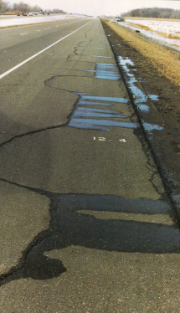
Presentation Outline
City of Albertville (May 22)
  NRRA Team Updates
  Intelligent Compaction (HMA)
  In-Place Recycling
  Unbound Concrete Overlays
  Advanced Performance Monitoring
MnROAD Tours / Dinner

Slide 3
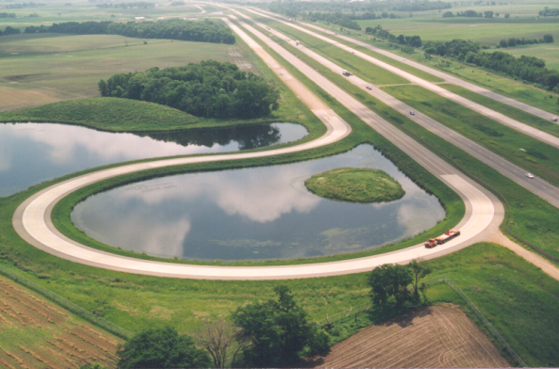
Resources Available
  MnROAD Facility
  Built in 1990’s at a cost of $25million ($76 million Today)
Nine miles of test pavements
  I-94 WB (Old Westbound/Mainline) & Low-Volume Road
50+ unique test cells open for future research
Instrumentation Network
Experienced technical staff

Slide 4
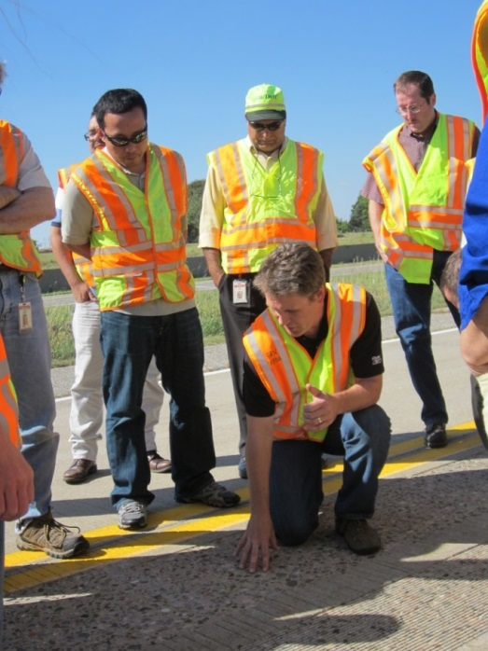
Mission Statement
Strategic Implementation Through Cooperative Pavement Research
Notes:
Building implementation, technology transfer, and training into research projects from the ground up.
Developing innovative technologies to improve pavement performance.
Fulfilling regional and national road research needs.
Examples
More can be done as a team
Practices should probably not changes as borders are crossed
States/Agencies projects are not unique
Effective solutions for common problems (more effective)
Foster innovation through membership from states, academia and industry

Slide 5







NRRA Agency Members
Greater Interest from
NY and Texas

Slide 6































NRRA Associate Members
Add Your
Company Here

Slide 7
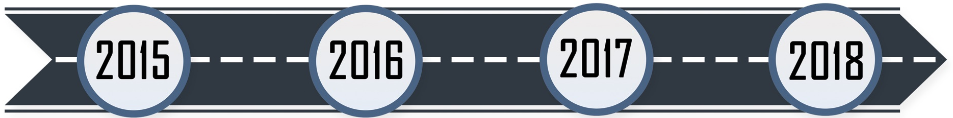
NRRA Team Timeline
Development
May – Starts
Develop Topics
Construction Plans
Plan Development
Short Term
Long Term*
Dec – Ends*
Short Term
Long Term
Construction
May – Pavement Conferences
December – Offsite Meetings
* Initial Ending Date – can be extended

Slide 8
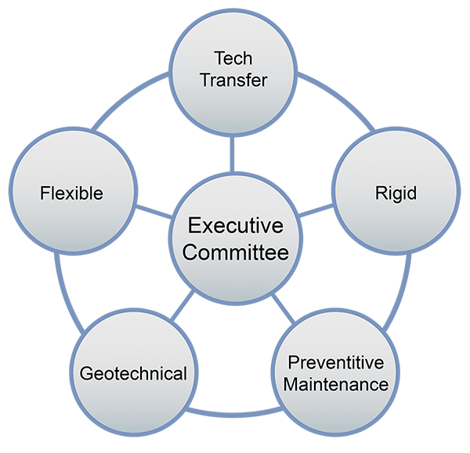
NRRA Participants/Structure
  Agencies and Minnesota LRRB
  Executive Committee
  $150,000/year
  Sets goals, prioritizes research objectives, and selects projects
Industry / Academia
  Associate Members
  $2,000/year
  Provide industry perspective and technical expertise

Slide 9
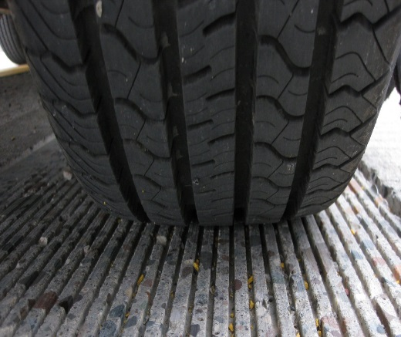
NRRA Current Funding
Income
  6 Agencies = $2,600,000
  31 Associates = $186,000
  MnDOT = $3,3000,000
  FHWA = $10,000
Funding Splits
  65% Research = $1,690,000
  30% Tech Transfer = $780,000
  5% Administration = $130,000

Slide 10
Short Term Research = $190,000
Process
Collect Information
1st Effort – MnDOT
NRRA Feedback
2nd Effort – MnDOT/Consultant
Publish
Flexible
  Tack Coats (initial start)
  Longitudinal Joint Performance (initial start)
Geotechnical
  Larger Subbase Materials
  Subgrade Design for New and Reconstructed
Rigid
  Design and Performance of Concrete Unbonded Overlays
  Repair of Joint Associated Distress Pavements
Pavement Maintenance
  Surface Characteristics of Diamond Ground PCC Surfaces
  Pavement preservation approaches for lightly surfaced roadways

Slide 11
Long Term Research ~$1,235,000
Project | Team | ~Test Sections ~ Distance | LRRB Funds? | Contracting Process
HMA Overlay and Rehab of Concrete and Methods of Enhancing Compaction | Flex | 12 - 7400’ | Yes | Master RFP
Cold Central Plant Recycling | Flex | 4 Cells - 1500’ | Yes | TRAP Direct
Fiber Reinforced Concrete Pavements | Rigid | 1 Cell - 500’ | Yes | Master Direct
Long Term Effects of Diamond Grinding | Rigid | LVR Loop |  | Hold
Early Opening Strength to Traffic | Rigid | 5 Cells - 500’ |  | Master Direct
Optimizing the Mix Components for Contractors | Rigid | 2 Cells - 500’ |  | Master Direct
Compacted Concrete Pavement for Local Streets | Rigid | 2 Cells - 500’ | LRRB | Master RFP
Recycled Aggregates in Aggregate Base and Larger Subbase Materials | Geo Tech | 8 Cells - 1800’ |  | Master RFP
Maintaining Poor Pavements | PM | 3 Cells - 1500’ | LRRB | TRAP Direct
Partial Depth Repair | PM | 15 Locations |  | TRAP Direct
Mainline (I-94) and Old Westbound (I-94)
Low Volume Road

Slide 12
NRRA Team
Workshop Discussion
Time Commitment?
Topics Selection?
What is missing?
How to take better advantage of Tech Transfer?
Research Pays Off Seminar Series
Combining of Efforts
  Coordinated State Lead Research Projects?
  FHWA Coordination
MnROAD Push Non-Traditional Pavement Innovation?
MnROAD Push for Non-Pavement Innovation?
Notes:
Who is getting the research pays off
Automated vehicles
Environmental – Erosion Control

Slide 13
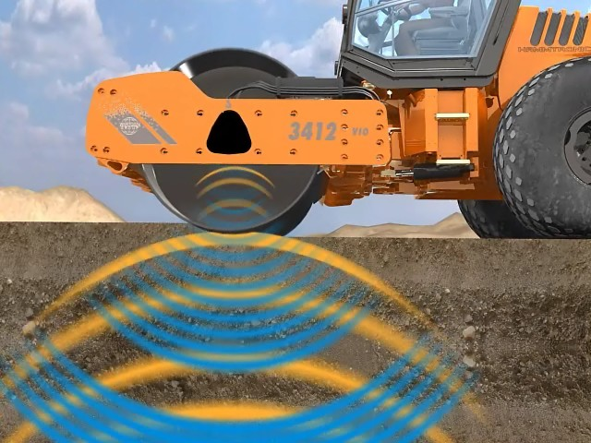
INTELLIGENT COMPACTION
NRRA Conference May 23-24, 2017
Presenter: Joseph Holland (Caltrans Research)
Prepared by: Ebi Fini, P.E (Caltrans Contruction)

Slide 14
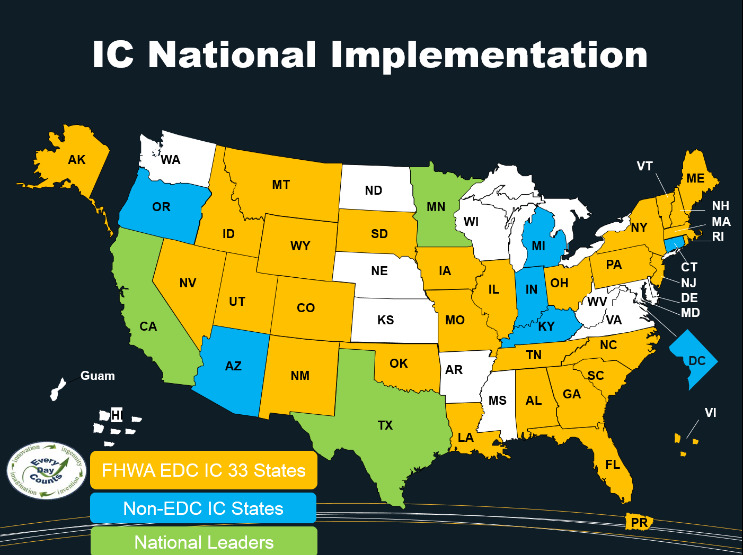

Slide 15
Premature Pavement Failure
Courtesy of Mark Woolaver, VAOT

Slide 16
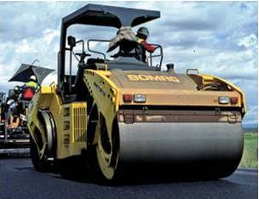

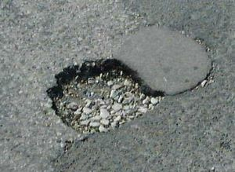
Why Intelligent Compaction (IC)?
Shortcomings in Conventional Compaction
Under-
Compaction
Leads to
Distresses
Limited
Feedback
Over-
Compaction

Slide 17
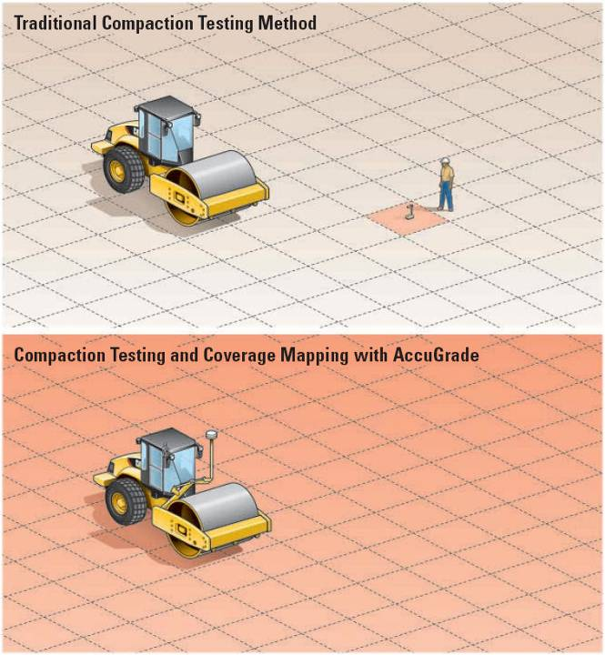
1 / 1,000,000
(IC)
100 % Coverage
Courtesy of Caterpillar

Slide 18
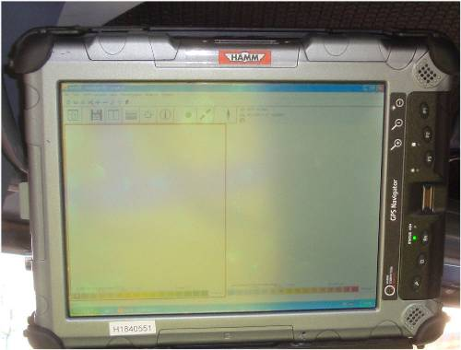
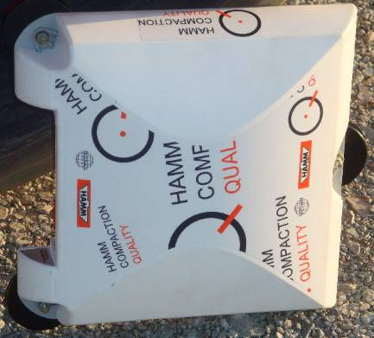
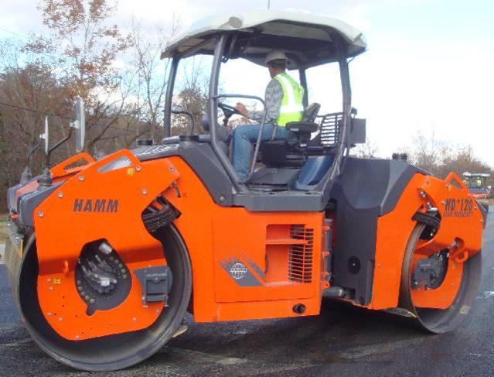
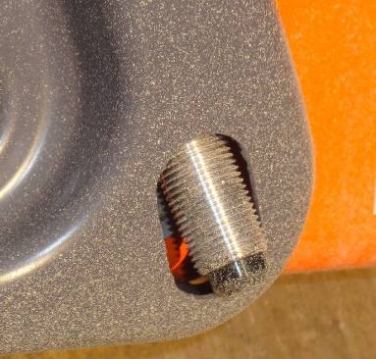
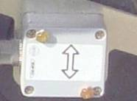
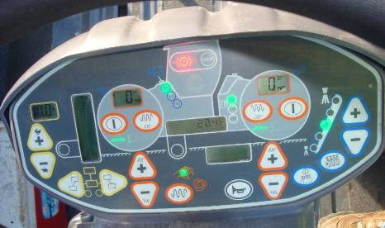
An Example IC System
HCQ GPS Navigator
GPS Receiver
Temperature Sensors
Accelerometer
Control Panel

Slide 19

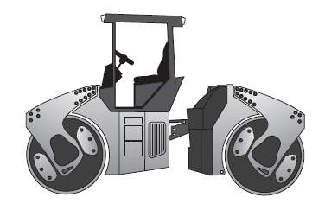
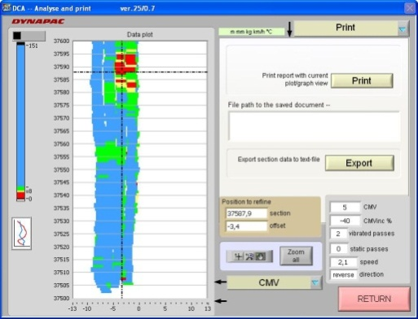
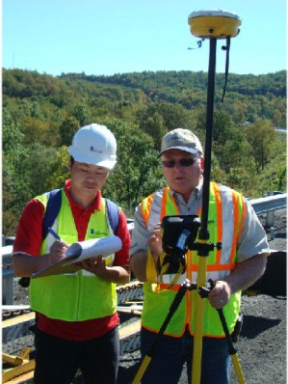
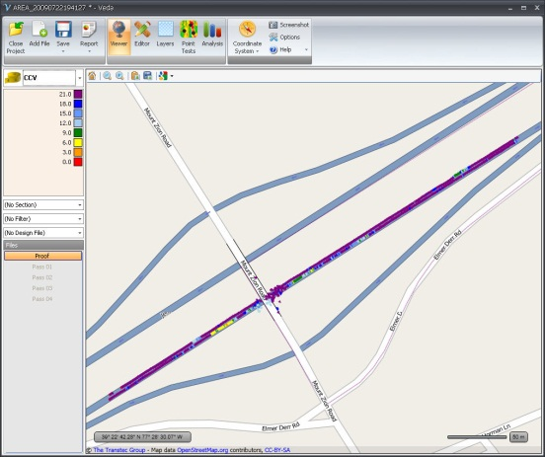

IC Data Flow
IC data
Vendor’s software
Point Tests and GPS data

Slide 20
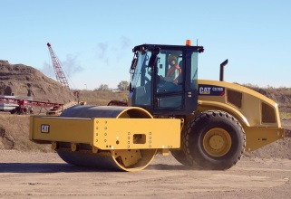

Many Systems …One Software

Slide 21
Intelligent Compaction
Workshop Discussion Topics
How other states can best deploy this technology?
Contractor Acceptance?
Specifications
Notes:
Who is getting the research pays off
Automated vehicles
Environmental – Erosion Control

Slide 22
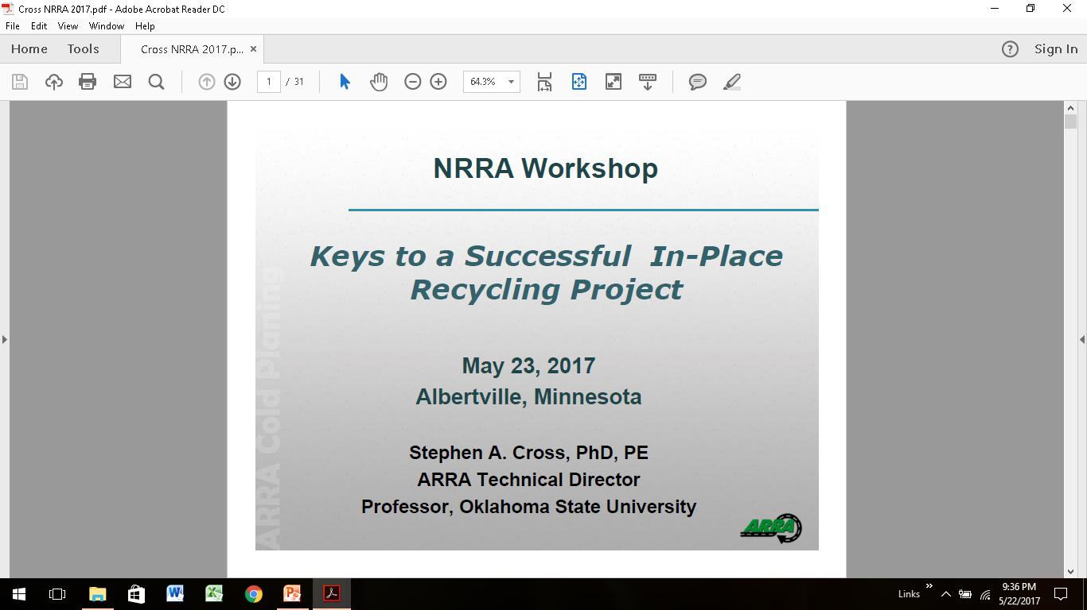

Slide 23
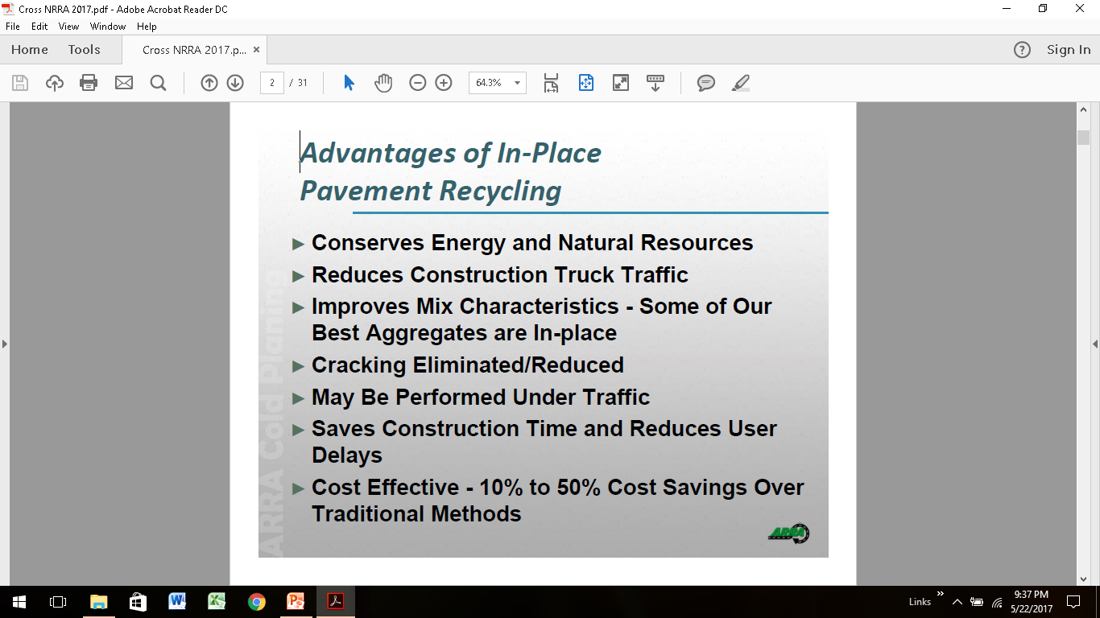

Slide 24
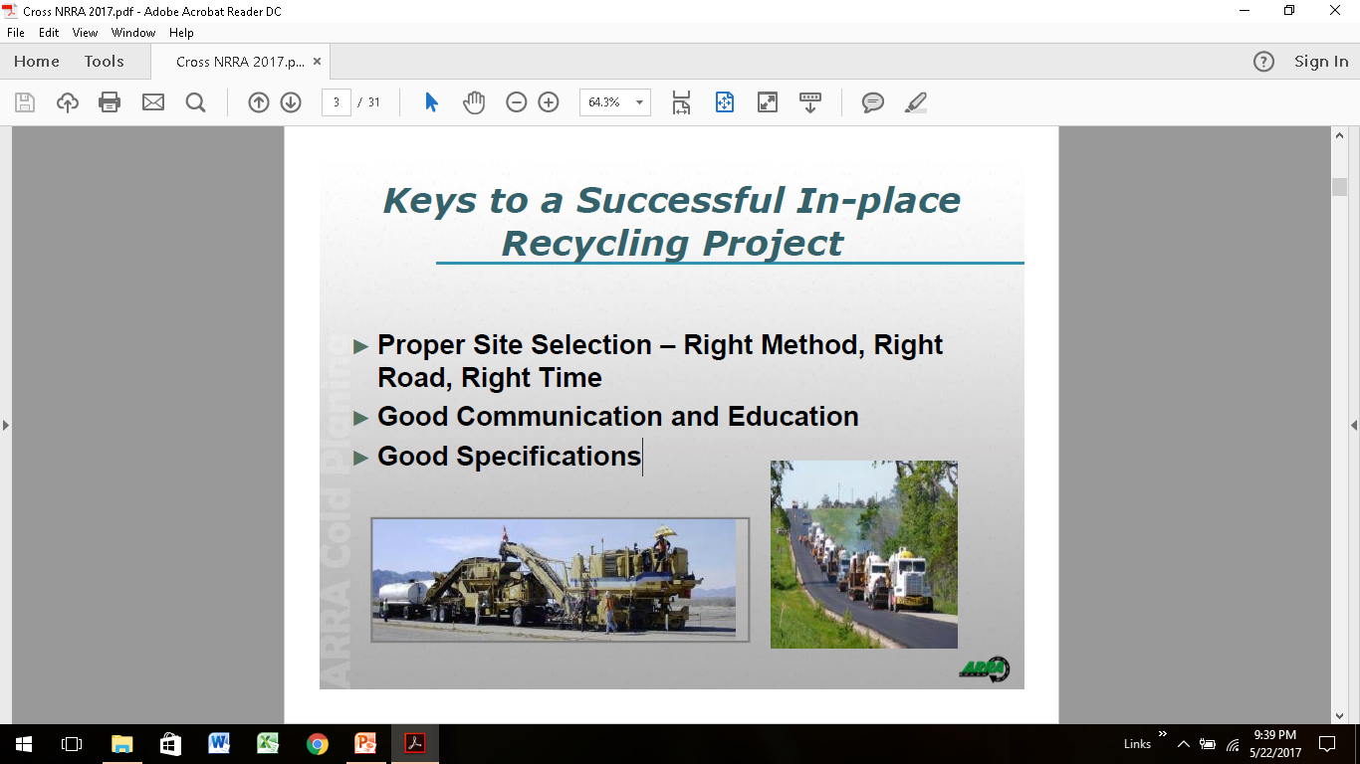

Slide 25
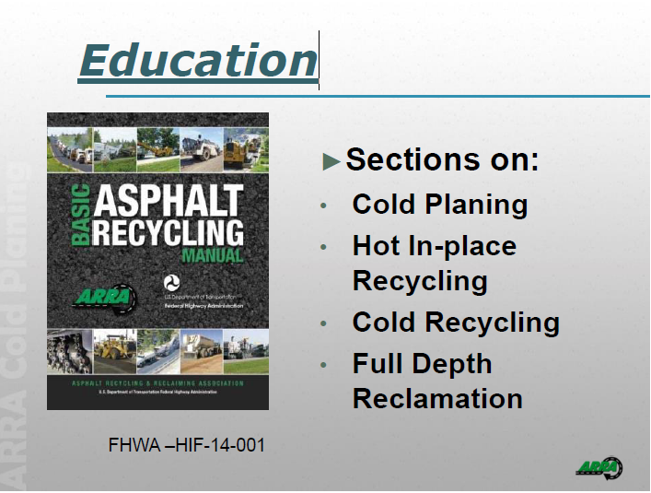

Slide 26
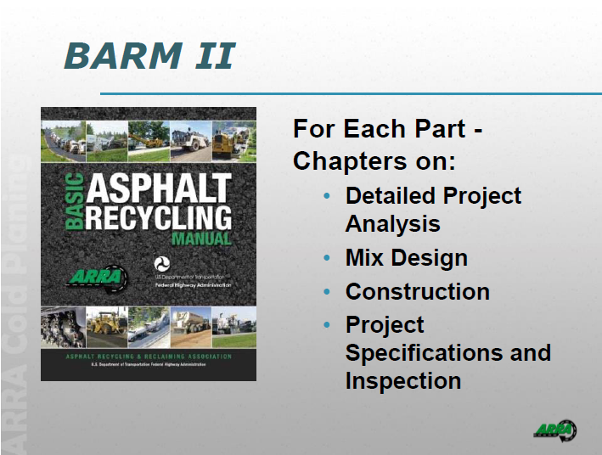

Slide 27
In-Place Recycling
Discussion Topics
How to change traditional contracting ways?
Design values of materials in-place strength/ layer coefficients?
Mix design needs?
New products?
Keys for project selection
Additional research needed (like NCHRP 9-62 project)?
Notes:
Who is getting the research pays off
Automated vehicles
Environmental – Erosion Control

Slide 28

Notes:
Who is getting the research pays off
Automated vehicles
Environmental – Erosion Control

Slide 29
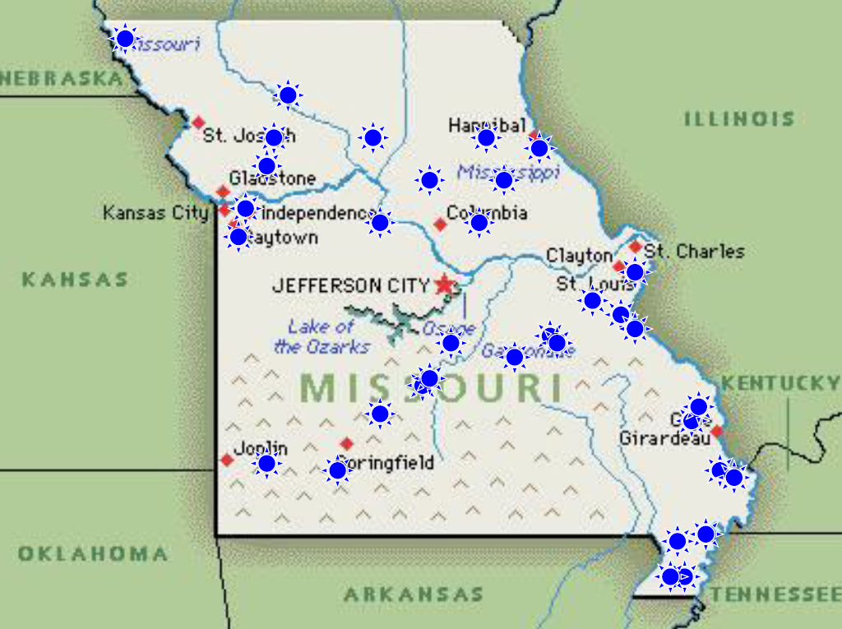
Notes:
Who is getting the research pays off
Automated vehicles
Environmental – Erosion Control

Slide 30
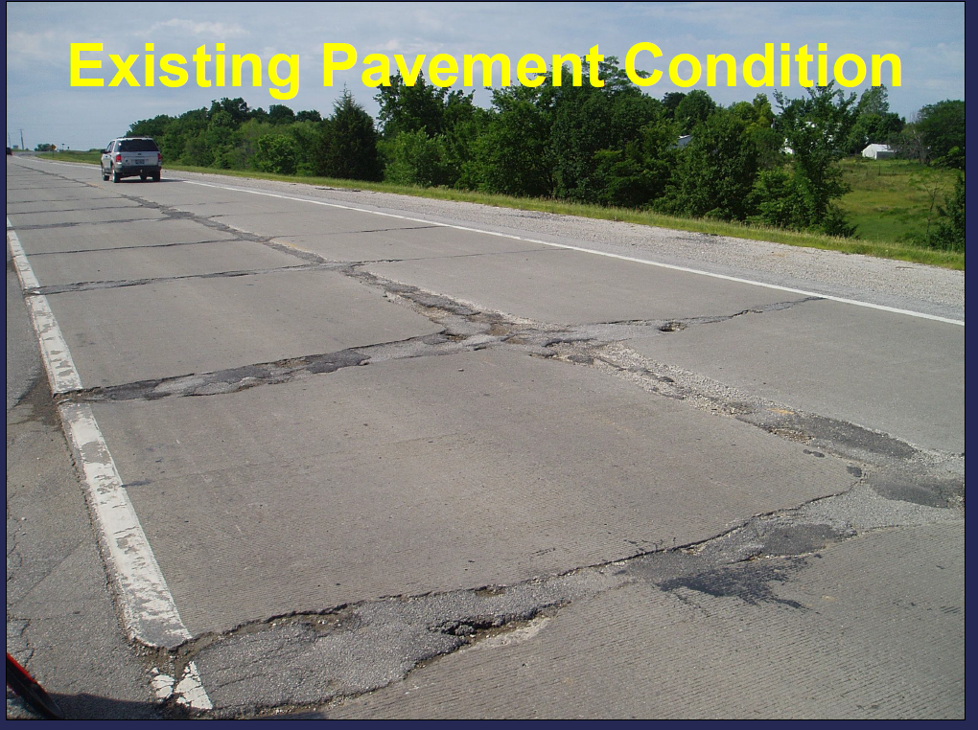
Notes:
Who is getting the research pays off
Automated vehicles
Environmental – Erosion Control

Slide 31
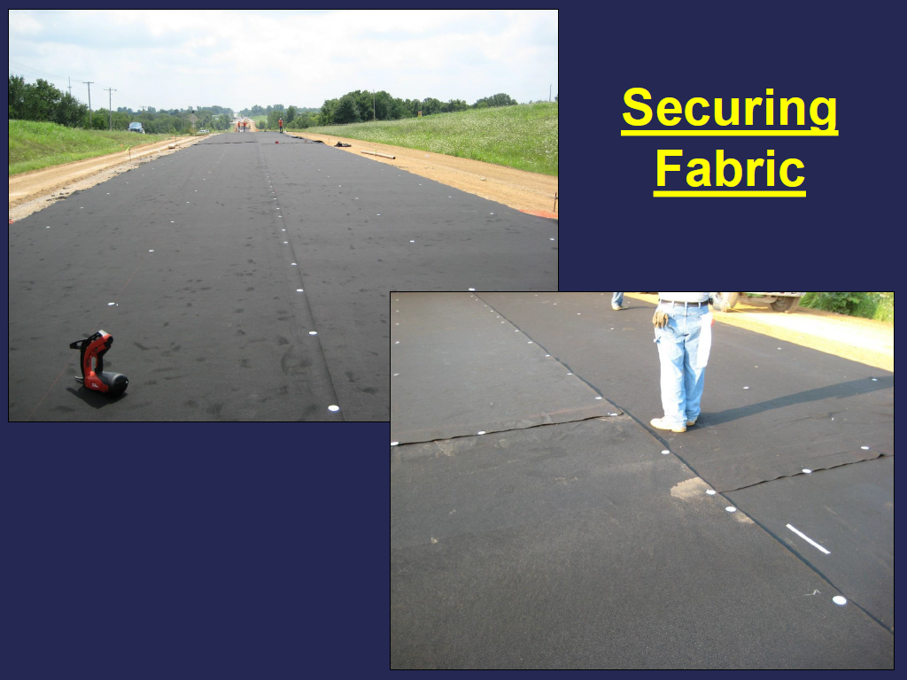
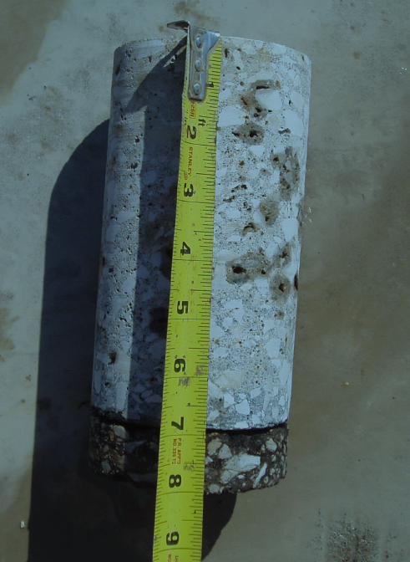
Notes:
Who is getting the research pays off
Automated vehicles
Environmental – Erosion Control

Slide 32
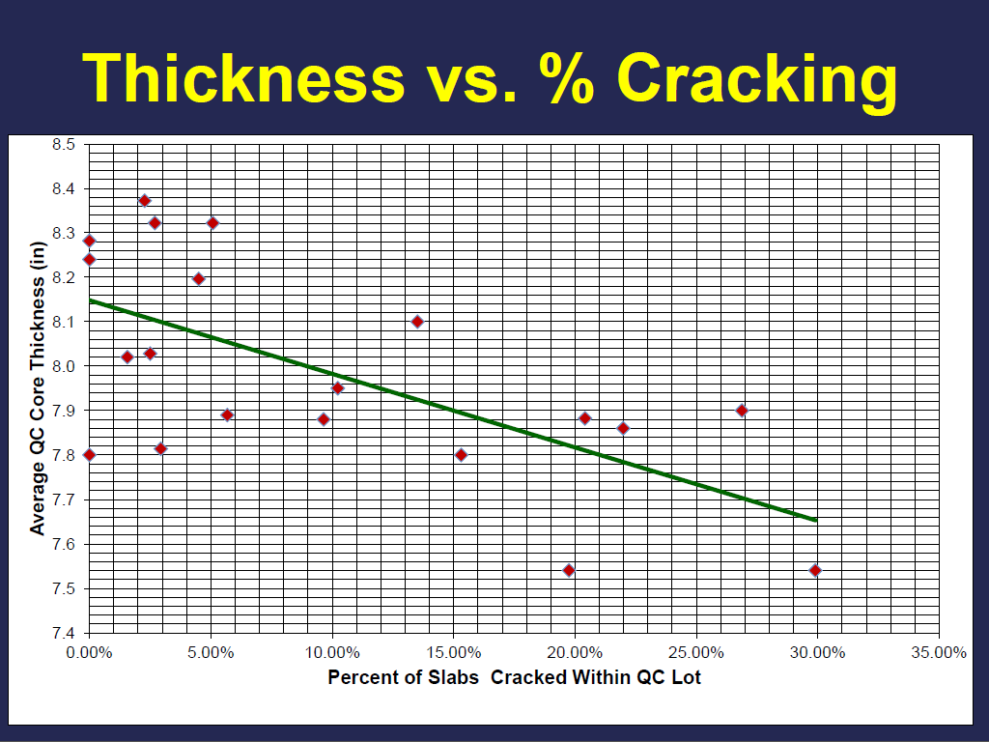
Notes:
Who is getting the research pays off
Automated vehicles
Environmental – Erosion Control

Slide 33
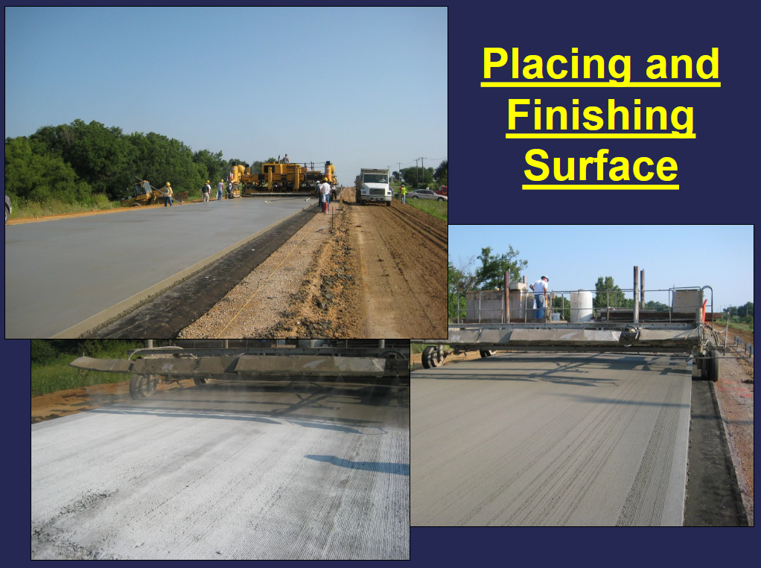
Notes:
Who is getting the research pays off
Automated vehicles
Environmental – Erosion Control

Slide 34
Successful Unbonded Concrete Overlays
Notes:
Who is getting the research pays off
Automated vehicles
Environmental – Erosion Control

Slide 35
Unbonded Concrete Overlay Discussion Topics
Thickness vs Cracking?
Interlayer performance?
Joint Deployment Issues / Traffic Effects / What should we do?
Fibers – Use or Not?
Finishing Details
How thin can we do? Bridge clearance / safety improvements
Notes:
Who is getting the research pays off
Automated vehicles
Environmental – Erosion Control

Slide 36
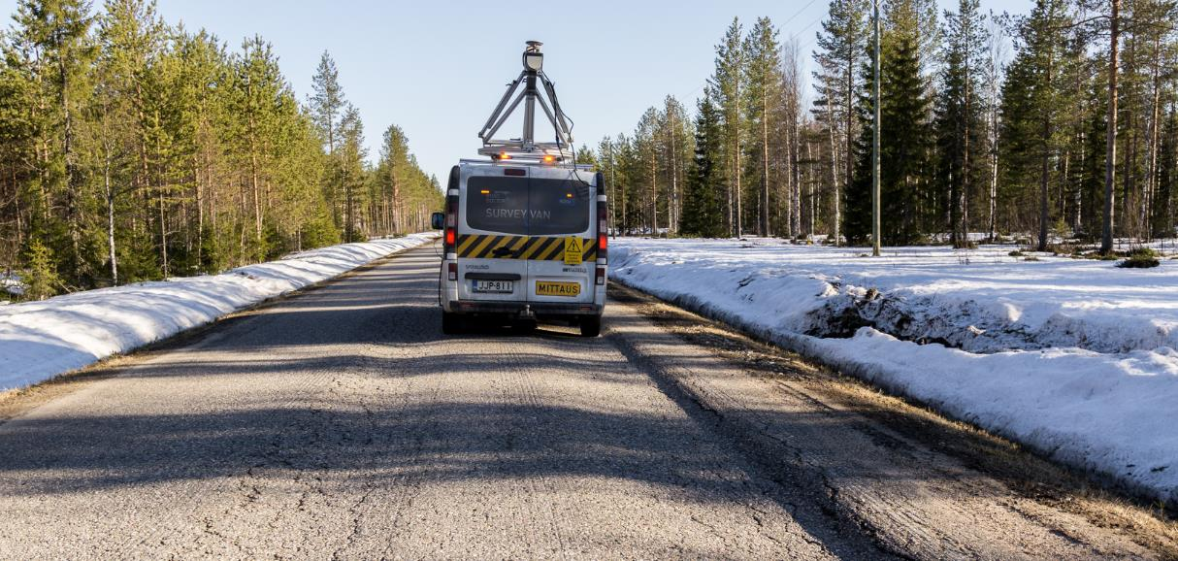
Workshop Topic #4--Advanced Performance Monitoring of Surface Condition
Timo Saarenketo, PhD, Adj.Prof.
CEO, Roadscanners Group
Finland, USA

Slide 37
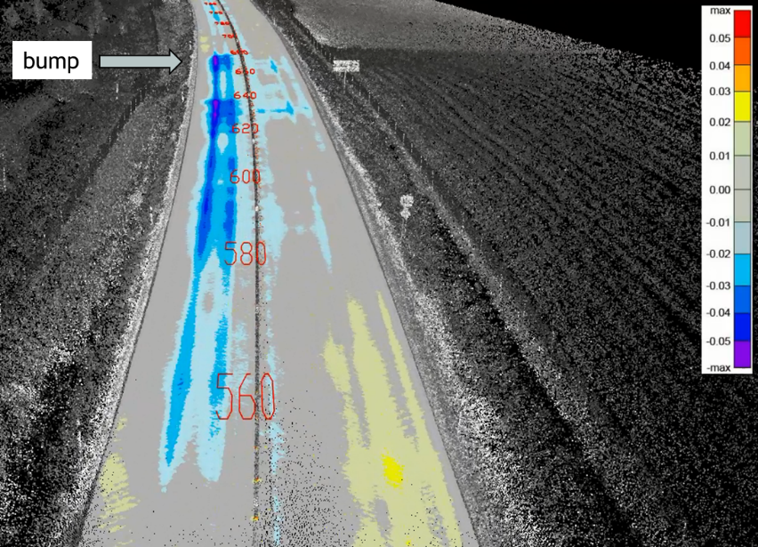
Factors Affecting Life Time of the Road
Structural condition
Functional condition
Road Width, Geometry, Visual Guidance
Heavy Vehicles Using the Road
Traffic Volume
Climatic Factors
Functional condition has a big effect on structural condition:
One bump has an effect to the pavement for almost 200 m within a speed of 80-100 km/h

Slide 38
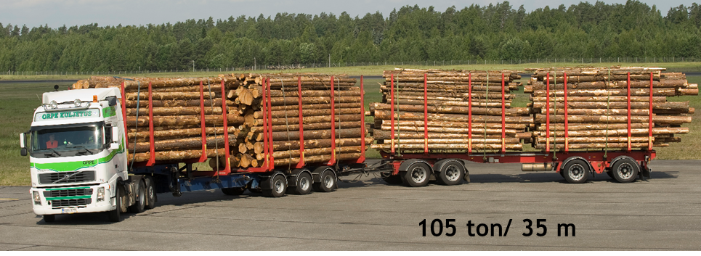

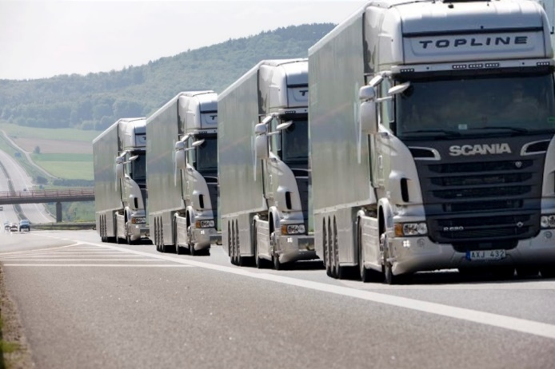
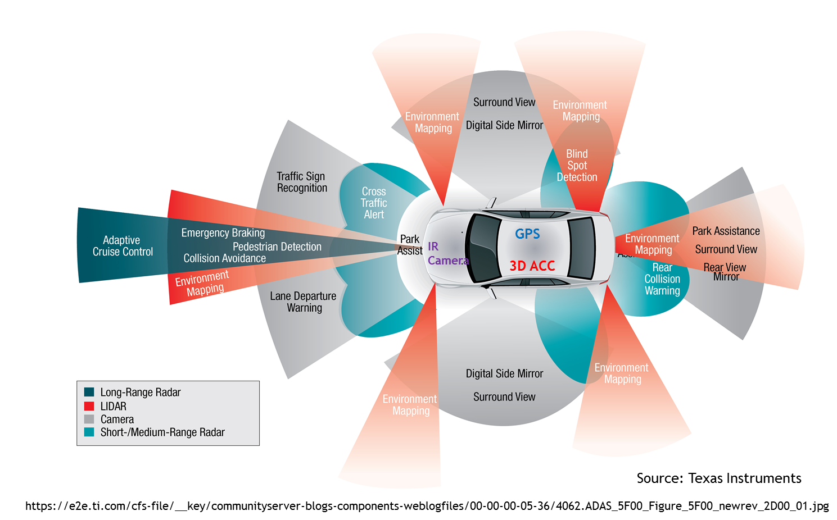
World is also changing: Heavier Trucks, New Tyres, Tyre Pressures, Autonomous Trucks and Platoon Driving, Climate Change

Slide 39
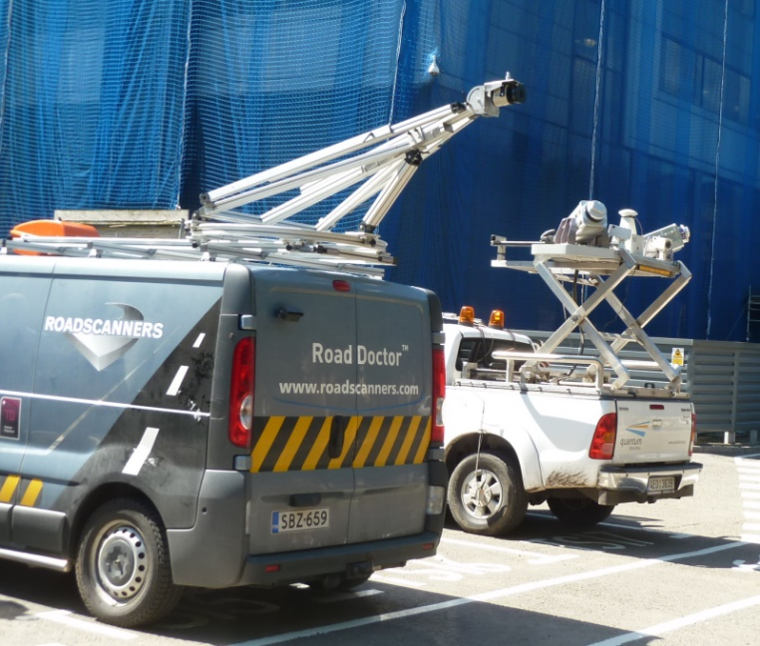
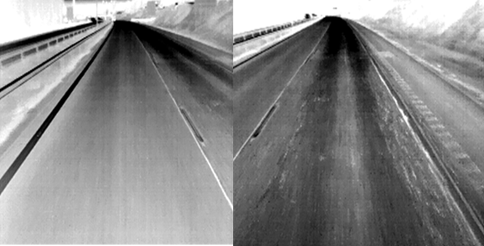
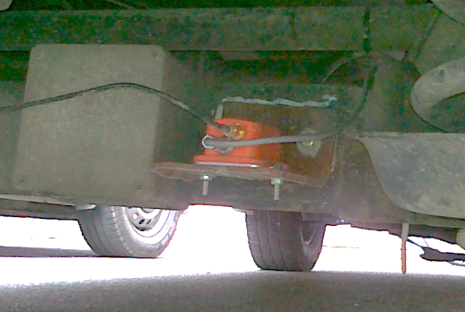
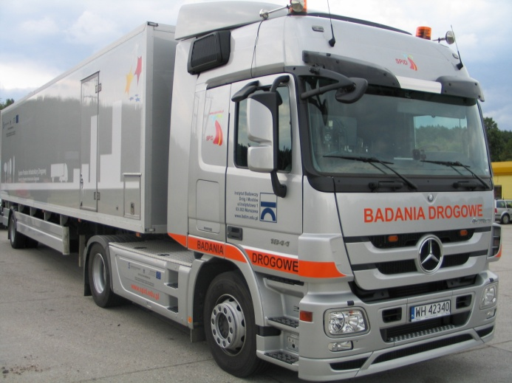
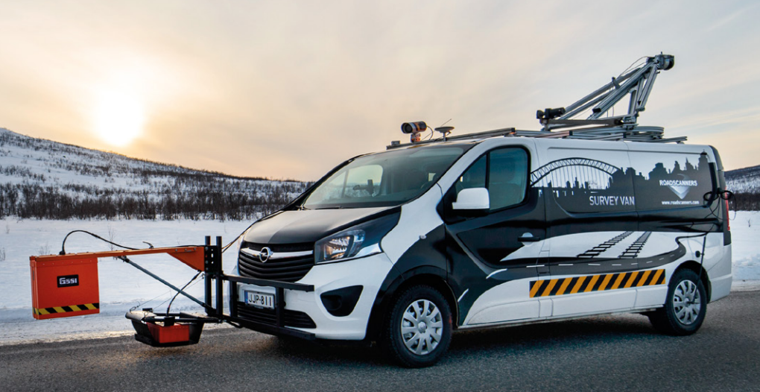
advanced road survey technologies currenlty used in finland
Laser scanner (lidar)
Digital video / IR techniques
3D accelerometers
Ground Penetrating Radar
Traffic Spped Deflectometer

Slide 40
Advance Performance Monitoring
Discussion Topics
Why Tyres not tires?
Difference in Europe and USA
What Advancements are still needed?
Pavement Management Needs vs Project Needs
How TSD and FWD used – Are they considered the same
Calculated Strain – how is it calculated
Surface Distress to Sub-Surface Condition
HMA Density of Surface Dielectric (New and Old Roads)
Notes:
Who is getting the research pays off
Automated vehicles
Environmental – Erosion Control

Slide 41
MnROAD Tour
Thank YOU

